Slide 1
REAL: Robust Estimation And Lifelong Learning
Liangzu Peng
Vision Lab Retreat
October 12, 2023

Slide 2
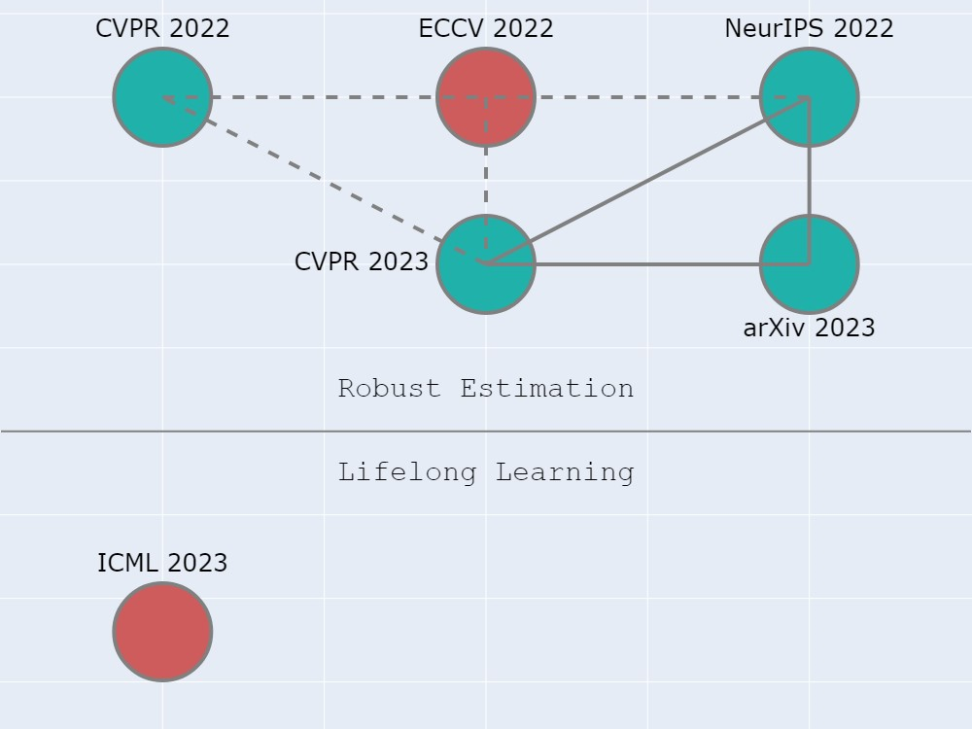
My REAL Work
Red:
Theory
Green:
Theory + Algorithm
Dash Line:
Weak Dependency
Solid Line:
Strong Dependency

Slide 3
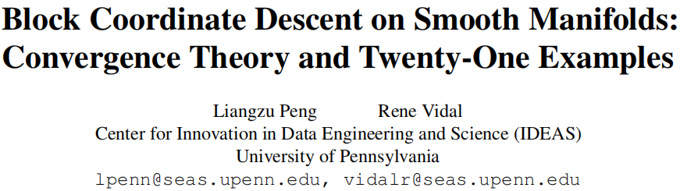

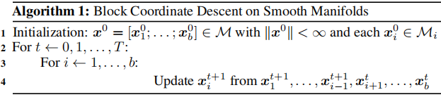

arXiv:2305.14744v2 [math.OC]
$F$: differentiable
$ℳ_{i}$: non-empty set

Slide 4

Different Update Rules
Block Exact Minimization:
Block Riemannian Gradient Descent:

Slide 5
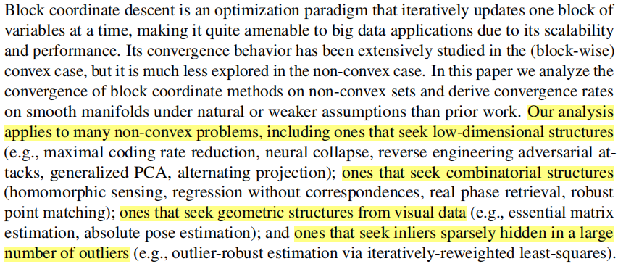
A Lab of Examples

Slide 6


Seek Geometric Structures via BCD
Essential Matrix Estimation
(Tianjiao’s Example)
(Ding et al.) Outlier-Robust Orthogonal Regression on Manifolds (In Submission)

Slide 7
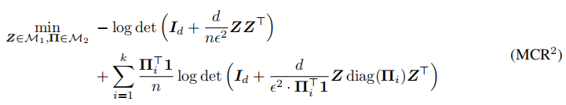

Seek Low-Dimensional Structures via BCD
Maximal Coding Rate Reduction
(Ryan Chan’s Example)
$Π_{i}$: i-th column of $Π$
(Chan et al.) ReduNet: A white-box deep network from the principle of maximizing rate reduction (JMLR 2022)

Slide 8

Seek Low-Dimensional Structures via BCD
Matrix Factorization & Neural Collapse
(Examples of Paris and Ben)
(Giampoura) Alternating iteratively reweighted least squares minimization for low-rank matrix factorization (TSP 2018)
(Haeffele & Vidal) Structured low-rank matrix factorization: Global optimality, algorithms, and applications (TPAMI 2019)

Slide 9
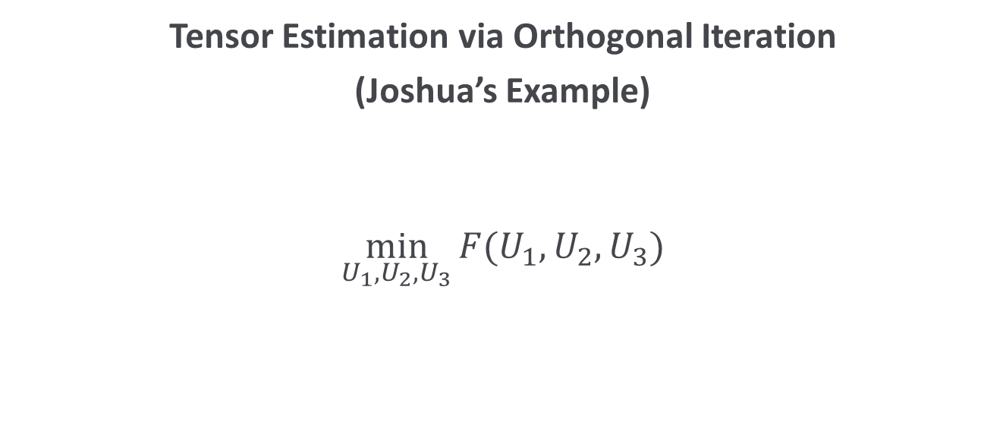
Seek Low-Dimensional Structures via BCD
Tensor Estimation via Orthogonal Iteration
(Joshua’s Example)
$$\min_{U_{1},U_{2},U_{3}}{F(U_{1},U_{2},U_{3}})$$

Slide 10

Seek Low-Dimensional Structures via BCD
RED
(Darshan’s Example)
$$\min_{x∈ℝ^{n}, z∈ℳ_{2}}{{\left|\left|y−G\left(z\right)−Ax\right|\right|}^{2}}+R(x)$$

Slide 11

Attention
SoftMax
(Salma’s Example)
$$\min_{U_{1},U_{2}}{F(softmax\left(U_{1}^{⊤}U_{2}\right)})$$

Slide 12

Seek Low-Dimensional + Geometric Structures
Generalized Principal Component Analysis
(Rene’s Example)
(Vidal) Generalized principal component analysis: An algebraic geometric approach to subspace clustering and motion segmentation (PhD Thesis)

Slide 13
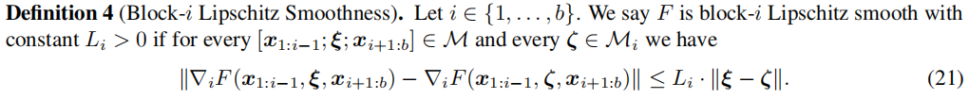


Theory
Theorem
Assume ($∀i$)
$F$ is block-$i$ Lipschitz smooth (with constant $L_{i}$)
$ℳ_{i}$ is a compact manifold of the Euclidean space
Then

Slide 14
My REAL Work

Slide 15
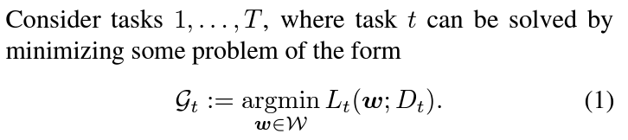


Continual Learning: Definition
Continual Learning:
Solve the tasks sequentially (from task $1$ to task $T$)
and find a common solution (model)
as economically as possible

Slide 16
Catastrophic Forgetting
You forever remember:
One plus one makes two
Two plus two makes five (1984, George Orwell)
Constructive comments from reviewers
(Non-)constructive comments from reviewers
“Standard” machine learning algorithms forget:
Have worse performance on task 1, after training on task 2
E.g., due to overfitting task 2
One main challenge of continual learning is to address catastrophic forgetting that occurs in “standard” machine learning algorithms

Slide 17
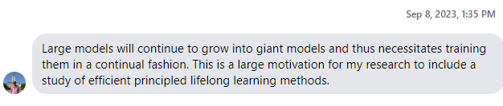

Continual Learning: Applications
Continual Training of Large Models
Improve the “Pretraining + Finetuning” Paradigm
Once finetuned with “standard” methods, the model will forget the pretrained knowledge

Slide 18
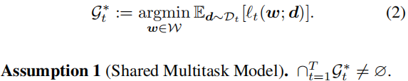
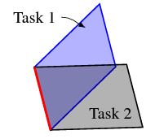



The Ideal Continual Learner (ICL)
Theorem
Under Assumption $1$, ICL never forgets.
ICL is an algorithm that sequentially solves (for $t=1,…,T$):
$c_{i}^{∗}$: Minimum value of task $i$
(Peng, Giampouras, Vidal) The Ideal Continual Learner: An Agent That Never Forgets (ICML 2023)

Slide 19

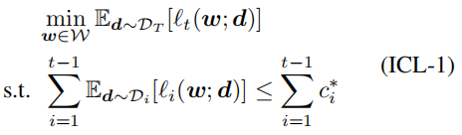
Implement ICL (Approximately)
Step 1: “Sum up” all constraints

Slide 20
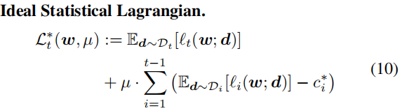
Implement ICL (Approximately)
Step 2: Lagrangian Multiplier

Slide 21
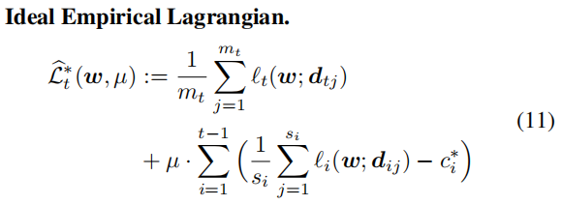
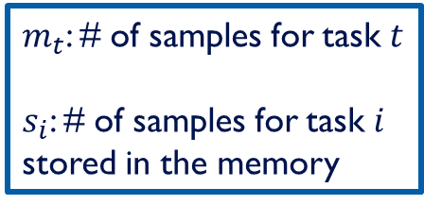
Implement ICL (Approximately)
Step 3: Empirical Rick Minimization
$m_{t}$: # of samples for task $t$
$s_{i}$: # of samples for task $i$ stored in the memory

Slide 22
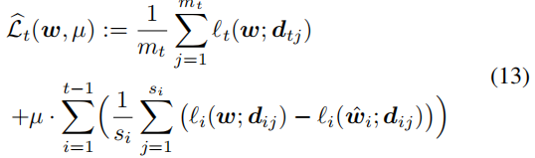

Implement ICL (Approximately)
Step 4: Approximate $c_{i}^{∗}$ by the loss at model ${\hat{w}}_{i}$ on task $i$

Slide 23
Implement ICL (Approximately)
Step 5: Solve (13) by a standard primal-dual algorithm
Call the method S as it sums up all constraints

Slide 24
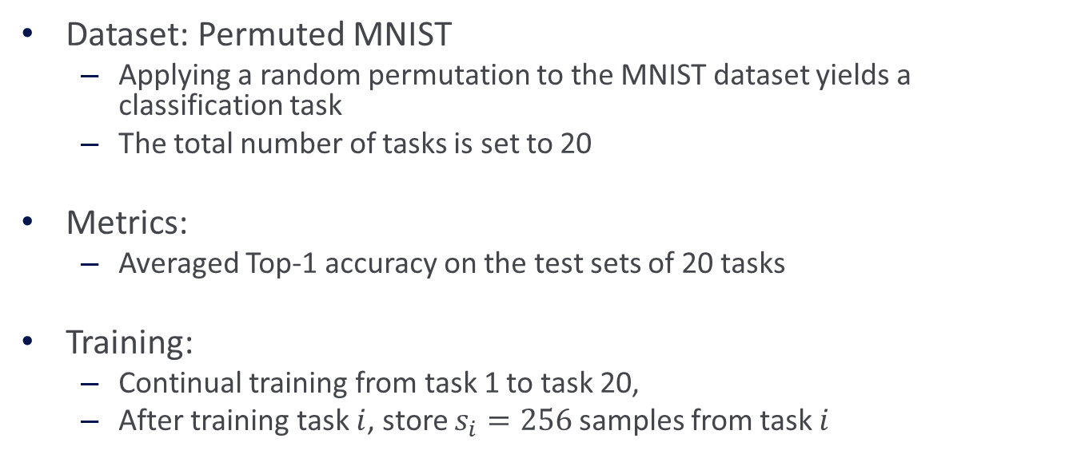
Experiment Setup
Dataset: Permuted MNIST
Applying a random permutation to the MNIST dataset yields a classification task
The total number of tasks is set to 20
Metrics:
Averaged Top-1 accuracy on the test sets of 20 tasks
Training:
Continual training from task 1 to task 20,
After training task $i$, store $s_{i}=256$ samples from task $i$

Slide 25
Exepriment Setup (cont.)
Baseline:
AGEM (Chaudhry et al., 2019)
Both AGEM and S need to sample some data from memory
Hyperparameter: memory batch size

Slide 26
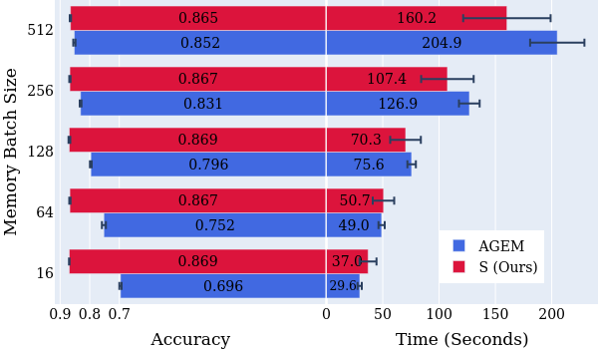
Experimental Results
S takes 29.6 seconds to reach accuracy 0.869
AGEM takes 204.9 seconds to reach accuracy 0.852

Slide 27
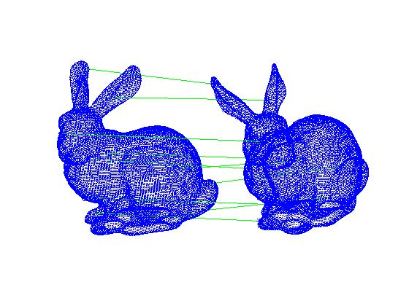
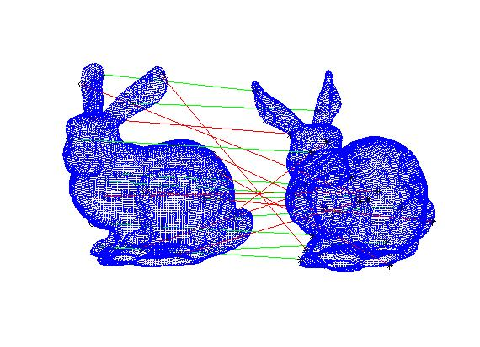
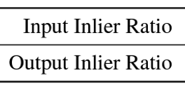
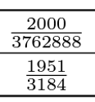
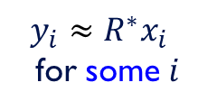
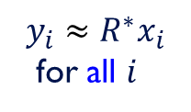
Retreat @JHU (2022)
ARCS: Accurate Rotation and Correspondence Search
CVPR 2022
(1) Outlier-Free
(2) With Outliers
$$y_{i}≈R^{∗}x_{i}$$
for all $i$
$$y_{i}≈R^{∗}x_{i}$$
for some $i$

Slide 28

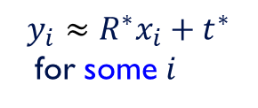
Retreat @SEAS.UPenn (2023)
SEAS: Outlier-Robust 3D Registration Made Simple, Efficient, And Scalable
In Preparation (80%)
Joint work with Tianyu Huang (CUHK)
And two advisors, Yun-Hui Liu (CUHK) and Rene Vidal
(2) With Outliers
(3) With Outliers
$$y_{i}≈R^{∗}x_{i}$$
for some $i$
$$y_{i}≈R^{∗}x_{i}+t^{∗}$$
for some $i$

Slide 29
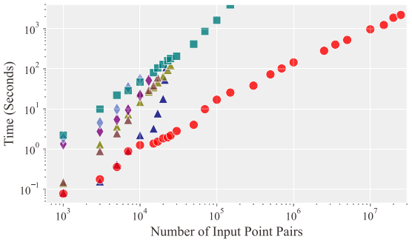
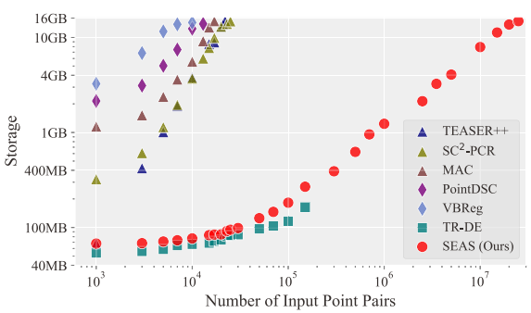
Retreat @SEAS.UPenn (2023)
S (Simple)
branch-and-bound
E (Efficient)
A (And)
S (Scalable)
Best Paper Award in Robot Vision (ICLR 2020)
Award Candidate
(CVPR 2023)
Deep Learning
(CVPR 2021)
(CVPR 2023)
Branch-and-Bound (CVPR 2022)

